Slide 1
Operating Systems
Again:12.16.17.33.35.38.40.43.50.52.58.63.64.65.67.71.73
Liu，Fagui

Slide 2
Who am I?
Prof. Fagui Liu (刘发贵 ）
BUAA/SCUT
Research: Cloud computing and big data for IoT, Edge computing,.
Cloud computing operating system based on domestic CPU. Guangdong Major Project of Basic and Applied Basic.
Phone: 020-39380283-3402,
E-mail: fgliu@scut.edu.cn

Slide 3
Overview
Teaching Assistants
谭壮伦， cstanzhuanglun@mail.scut.edu.cn
汤恬恬，745004955@qq.com，
Textbook
《现代操作系统》(中文版第四版)，Andrew S. Tanenbaum 著，陈向群等译，机械工业出版社
《Modern Operating System》(英文版第四版)，Andrew S. Tanenbaum，机械工业出版社
参考文献
《计算机操作系统教程》(修订版)，西安电子科技大学出版社
Operating System Design and Implementation, Andrew S.Tanenbaum, Prentice-Hall, 2003.

Slide 4
Course Outline
Time-line of lectures and assignments
Time-Due Topic Material Assignments
==========================================================
3-4: Introduction, Overview Ch.1 Reading Homework 1
5: Processes/Threads Ch.2.1,2.2,
6: CPU scheduling Ch.2.4
7: Process Synchronization Ch.2.3, 2.5 Homework 2
8: Deadlock Ch.6 Lab 1 & Test1 Homework 3
9: Memory Management Ch.3.1,2,3,
9~11 Virtual Memory Ch.3.4~8 Lab2 Homework 4
12~13File Systems Ch.4 Homework 5
14~15:I/O Systems Ch.5 Lab3 & Test2 Homework 6
16-17: Security Ch.9 Lab4
17-18：Case Study Ch. 10
19:EXAM

Slide 5
Lab &Test
Lab:第8-16周,4次,每次4节课，B3-138实验室
Test：第8~16周：2-3次与Lab同时进行,每次1小时
学生考试入口(教育科研网内）：
http://222.201.187.216
用户名：你的学号
口令：123456

Slide 6
Course Information
Prerequisites
Hardware: Computer Composition
Software: Data Structure, C++
Laboratory Facilities
Linux
Notes:
You should all have taken Computer Composition . Students have a set of responsibilities. This is not a 200 level course. 300 level courses require you to do much more individual study. Read the text book. Try things out on UNIX or Windows. Browse the web site. Look at the OS news groups.
You may use any Computer, but if you have problems the machines in the Sparc Lab and the engineering college workstation lab are set up to be appropriate for your use although a personal PC will do as well.
It is up to you to make sure you are using the right software so that you can hand your machine problems in on-time.

Slide 7
Why are you here?
Fulfill the requirement
Prerequisite for other courses
Network
Distributed systems
Real-time systems
Multimedia systems
Future plans
Graduate schools for CS
Employment

Slide 8
About this course…
Principles
System concepts
OS design
Some theory（理论）
Rationale(理论基础)
Practice
Goals
Understand OS decisions
Basis for future learning
Control computer

Slide 9
Lecture Format
Help you understand important and hard OS concepts
Group discussions
Animation (动画演示）
Real life examples
Lectures do not cover everything
Not all questions in quizzes or exams are from lectures
Students responsibility
Attend lectures
Read textbooks
Quiz, Lab, Homework, Test, Exam

Slide 10
Why so many grades?
Intended to reduce pressure/anxiety
More data points = less noise
Final exam: 40%
Discussions , Quizzes &Test : 20%
Homework : 20%
Labs: 20%

Slide 11
Chapter Outline
What is OS? What does it do?
History of OS
The Operating System Zoo
Computer Hardware overview
Operating System Concepts
System Calls
Operating Systems Structure
Summary

Slide 12
What Is An Operating System (1)
A modern computer consists of:
One or more processors，(CPU)
Main memory
Disks
Printers
Various input/output devices
Managing all these components requires a layer of software – the operating system

Slide 13
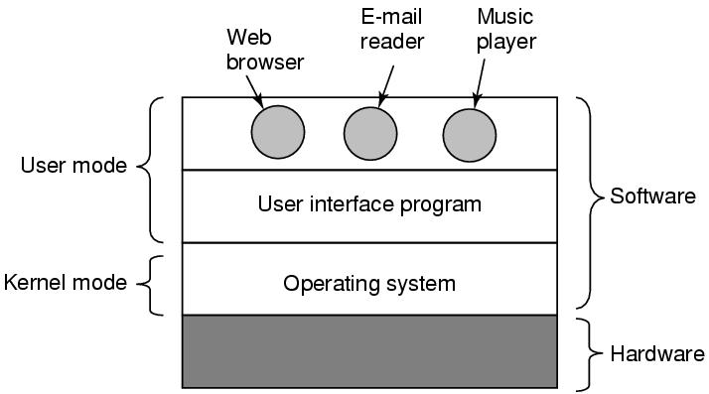
What Is An Operating System (2)
Figure 1-1. Where the operating system fits in.

Slide 14
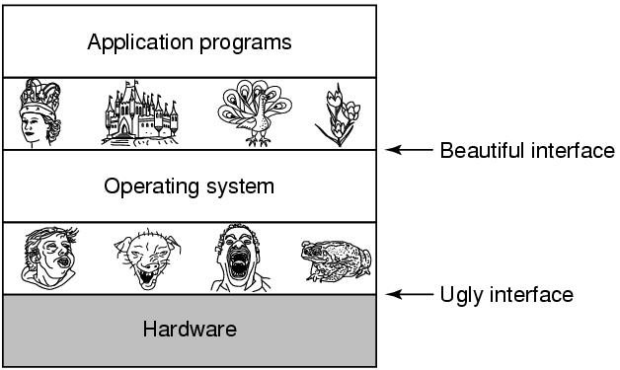
The Operating System as an Extended Machine
Figure 1-2. Operating systems turn ugly hardware into beautiful abstractions.

Slide 15
The Operating System as a Resource Manager
Allow multiple programs to run at the same time
Manage and protect memory, I/O devices, and other resources
Includes multiplexing（复用） (sharing共享) resources in two different ways:
In time
In space

Slide 16
What Is an OS?
“Code” that:
Sits between programs & hardware
Sits between different programs
Sits betweens different users
But what does it do?
to provide an orderly and controlled allocation of the processors, memories and I/O devices among the various programs competing for them
Real life example:
Government?

Slide 17
What Is an OS?
Resources
Allocation(分配)
Protection(保护)
Reclamation(回收)
Virtualization(虚拟化)
Services
Abstraction(抽象)
Simplification(简化)
Convenience(方便)
Standardization(标准化)
Makes computers simpler

Slide 18
What Is an OS?
Resources
Allocation
Protection
Reclamation
Virtualization
Finite resources
Competing demands
Examples:
CPU
Memory
Disk
Network
Government
Limited budget, Land, Oil, Gas,
Linux or Windows?
Democrat or Republic(民主党党员或共和国 )?

Slide 19
What Is an OS?
Resources
Allocation
Protection
Reclamation
Virtualization
You can’t hurt me
I can’t hurt you
Implies some degree of safety & security
Government
Law and order

Slide 20
What Is an OS?
Resources
Allocation
Protection
Reclamation
Virtualization
Government
Income Tax
所得税
The OS giveth
The OS taketh away
Voluntary(自愿的) at run time
Implied at termination
Involuntary(非自愿的)
Cooperative

Slide 21
What Is an OS?
Resources
Allocation
Protection
Reclamation
Virtualization
Illusion（幻想） of infinite（无限的）, private resources
Memory versus disk
Timeshared CPU
More extreme cases possible (& exist)
Government
Social security
（社会保障）

Slide 22
Chapter Outline
What is OS? What does it do?
History of OS
The Operating System Zoo
Computer Hardware overview
Operating System Concepts
System Calls
Operating Systems Structure
Summary
22/75

Slide 23
History of Operating Systems
First generation 1945 – 1955 (Anarchy无政府状态)
vacuum tubes(真空管), plug boards（插件板：一种有孔的板。由人工插入插头，可以控制设备的操作）
Second generation 1955 – 1965 (Monarchy君主政体)
Transistors(晶体管) and batch systems (批处理系统)
Third generation 1965 – 1980 (Feudalism封建制度)
ICs and Multiprogramming(集成电路和多道程序设计)
Fourth generation 1980 – present (Capitalism资本主义or Communism（共产主义)
personal computers（个人计算机）
Fifth generation 1990 – present
mobile computer （移动计算机）

Slide 24
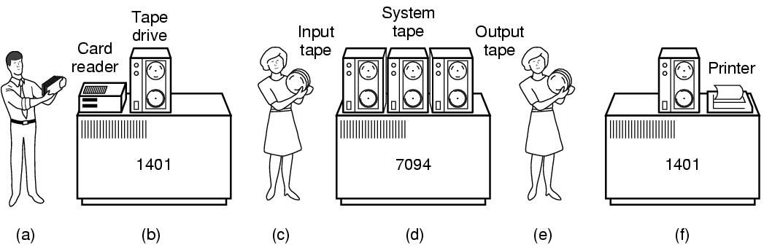
Transistors and Batch Systems (1)
Figure 1-3. An early batch system.
Programmers bring cards to 1401.
(b)1401 reads batch of jobs onto tape.
(c) Operator carries input tape to 7094.
(d) 7094 does computing.
(e) Operator carries output tape to 1401.
(f) 1401 prints output.
Notes:
晶体管和批处理系统

Slide 25
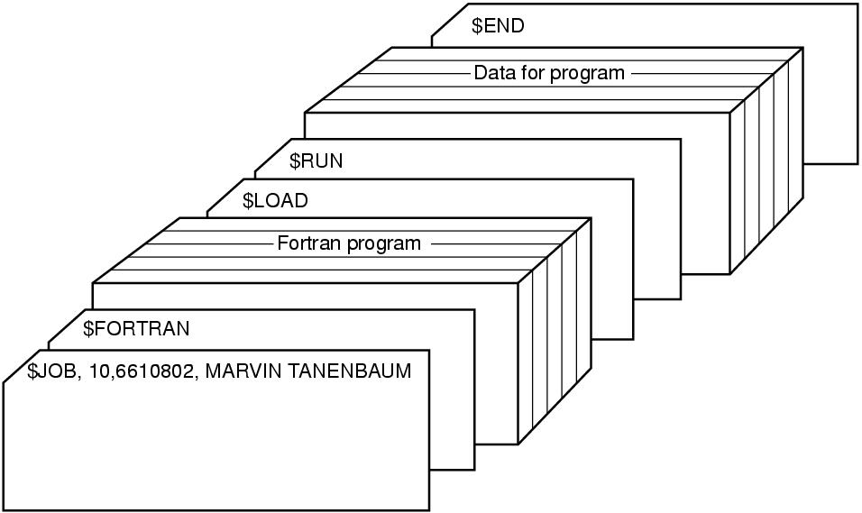
Transistors and Batch Systems (2)
Figure 1-4. Structure of a typical FMS job.

Slide 26
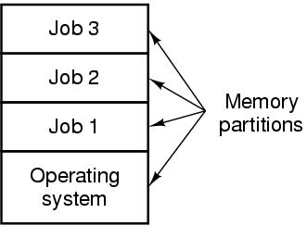
ICs and Multiprogramming
Figure 1-5. A multiprogramming system with three jobs in memory.
Notes:
IC和多程序设计

Slide 27
Personal Computers
CP/M
DOS, MS-DOS
Macintosh
Windows XP/Vista…
UNIX
Linux

Slide 28
Chapter Outline
What is OS? What does it do?
History of OS
The Operating System Zoo
Computer Hardware overview
Operating System Concepts
System Calls
Operating Systems Structure
Summary
28/75

Slide 29
The Operating System Zoo (Capitalism or Communism)
Mainframe operating systems:OS390(批处理、事务处理、分时处理）
Server operating systems: Linux，Free BSD，Windows Server 200x，中标麒麟可信操作系统、中标麒麟服务器操作系统
Multiprocessor operating systems: Windows, Linux(如同配有通信、连接、一致性等专用功能的服务器操作系统）
Personal computer operating systems: （为单一用户） Linux
Handheld（掌上） operating systems: Plam OS，Android， Yun OS 、MIUI、EUI、FreemeOS
Embedded operating systems: VxWorks，QNX
Sensor node operating systems : TinyOS
Real-time operating systems(硬实时、软实时）: e-Cos
Smart card(智能卡） operating systems： COS

Slide 30
Historical Comparison
 | Mainframe | Mini | Micro
System $/ Worker Salary | 10:1 – 100:1 | 10:1 – 1:1 | 1:10-1:100
Goal | System utilization | Overall cost | Productivity
Target | Capacity | Features | Ease of Use

Slide 31
Chapter Outline
What is OS? What does it do?
History of OS
The Operating System Zoo
Computer Hardware overview
Operating System Concepts
System Calls
Operating Systems Structure
Summary
31/75

Slide 32
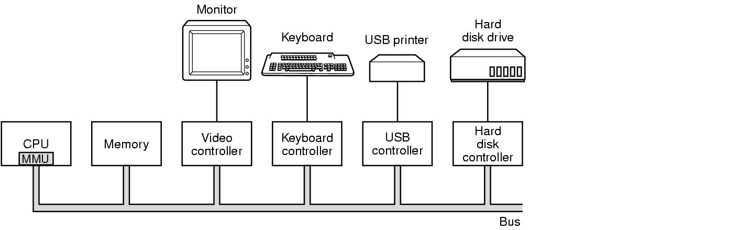
Computer Hardware Review
Figure 1-6. Some of the components of a simple personal computer.
CPU、内存以及I/O设备都由一条系统总线连接起来并通过总线与其他设备通信

Slide 33
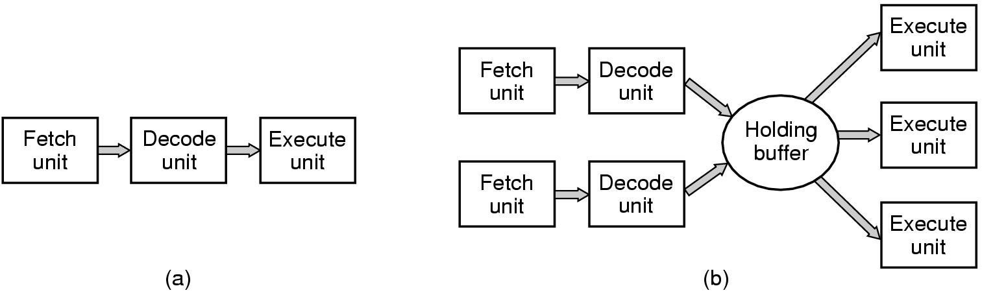
CPU（计算机的大脑） ----从内存中读出指令、解码并执行之）
*每个CPU都有其一套可执行的专门指令集。
*CPU有保存变量和临时结果的通用寄存器；还有专用寄存器：程序计数器(下一条指令的内存地址）、堆栈指针（指向内存中当前栈的顶端）、PSW（程序状态字：包含了条件码位、CPU优先级、CPU模式（用户态或内核态）、以及各种其他控制位）等
用户程序从OS获得服务，必须使用系统调用（system call）陷入内核并调用OS.TRAP指令把用户态切换成内核态，并启动OS.
读取指令n+2
指令n+1解码
执行指令n
(a) A three-stage pipeline(三阶段的流水线“取指，解码，执行”)
(b) A superscalar CPU(一个超标量CPU)：有多个执行单元（如一个CPU用于整数算术运算、一个用于浮点算术运算、另一个用于布尔运算）

Slide 34
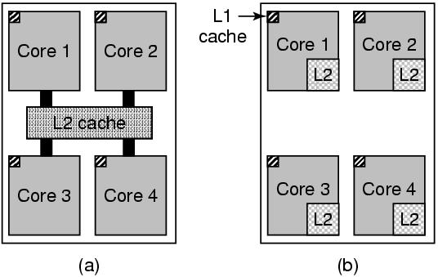
Multithreaded and Multicore Chips
Figure 1-8. (a) A quad-core chip with a shared L2 cache（带有共享L2缓存的4核芯片）（Intel多核芯片）. (b) A quad-core chip with separate L2 caches.（带有分离L2缓存的4核芯片（AMD多核芯片）
-----多核需要多处理机操作系统
二级L2缓存，访问存在1或2个时钟周期延时
多线程（Multithreaded）或超线程（hyperthreading）
Notes:
Hyperthreading早先称为Jackson技术，这是一种多线程（SMT Simultaneous Multi-Threading，SMT同步多线程）技术的扩展，其主要功能就是让处理器在单处理器工作模式下也进行多线程工作（每块处理器可以同时进行一个以上进程的处理）。

Slide 35
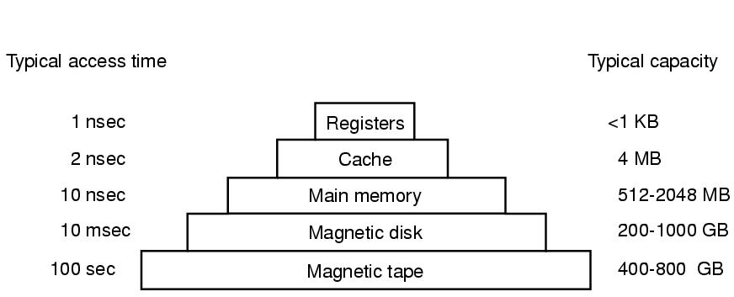
Memory (1)
1~8GB
1~4TB
Figure 1-9. A typical memory hierarchy. The numbers are very rough approximations.
现代CPU设计中设计了两个缓存：第一级L1缓存在CPU中，访问不存在延时；二级L2缓存，访问存在1或2个时钟周期延时。
Notes:
CPU的寄存器。其典型容量是：在32位CPU中为32╳32位，而在64位CPU中为64╳64位，这两种情形下，其容量都小于1KB.

Slide 36
Memory (2)
Questions when dealing with cache:
When to put a new item into the cache.
Which cache line to put the new item in.
Which item to remove from the cache when a slot is needed.
Where to put a newly evicted item in the larger memory.

Slide 37
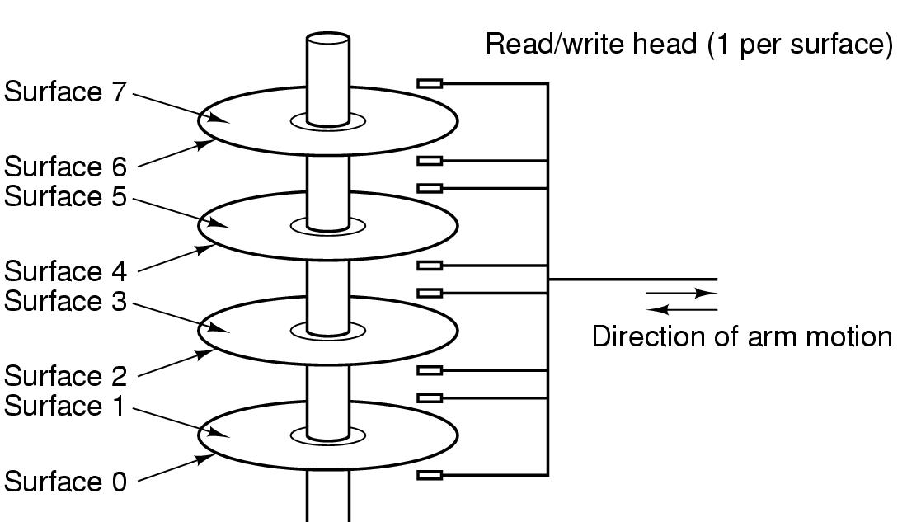
Structure of a disk drive
Track磁道、cylinder柱面、sector扇区
附：固态硬盘(闪存)、虚拟内存、地址映射、存储管理单元MMU

Slide 38
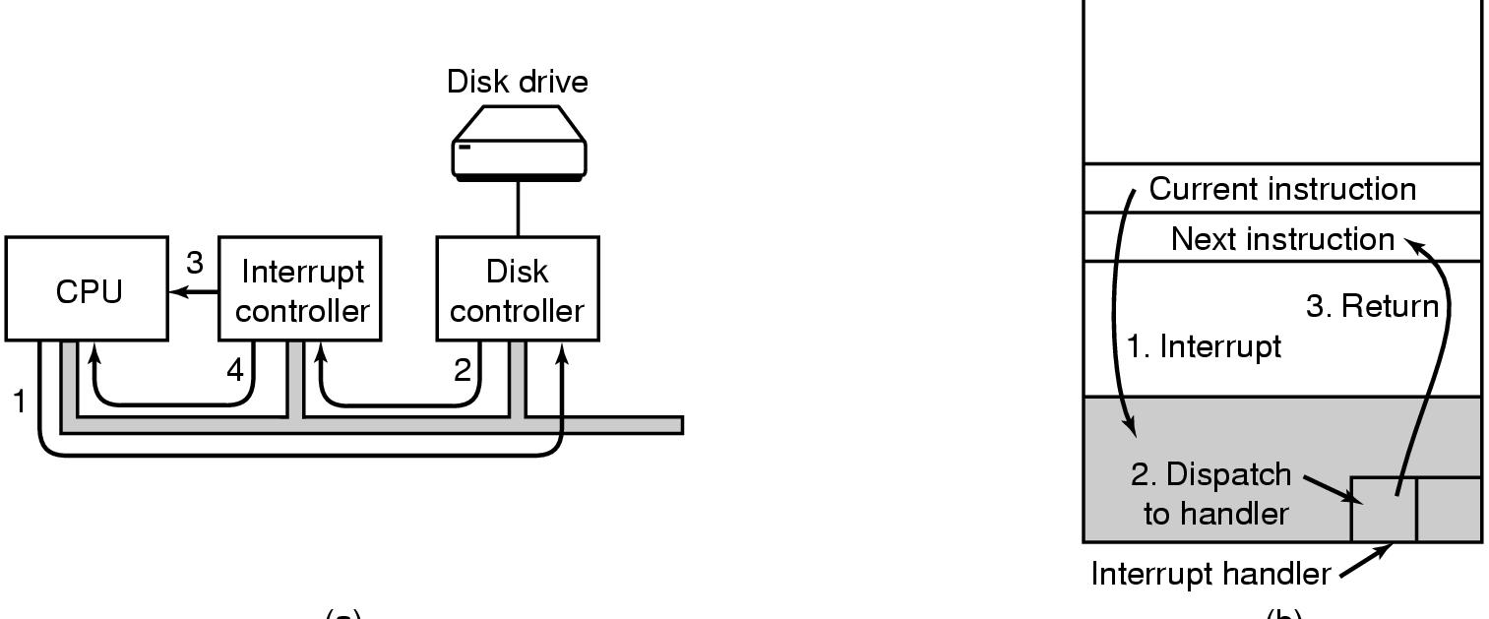
I/O device and interrupt
I/O device一般包含设备控制器和设备本身。
OS需要使用设备驱动程序来控制设备控制器
Step3：如果中断控制器正忙于一更高级的中断，可能不接受，会在CPU芯片的一个管脚上申明
Step4:中断控制器将发中断的设备的编号放到总线上，这样CPU可以读总线，获取哪个设备刚完成了操作
(a)
(b)
(a) Steps in starting an I/O device and getting interrupt
(b) How the CPU is interrupted

Slide 39
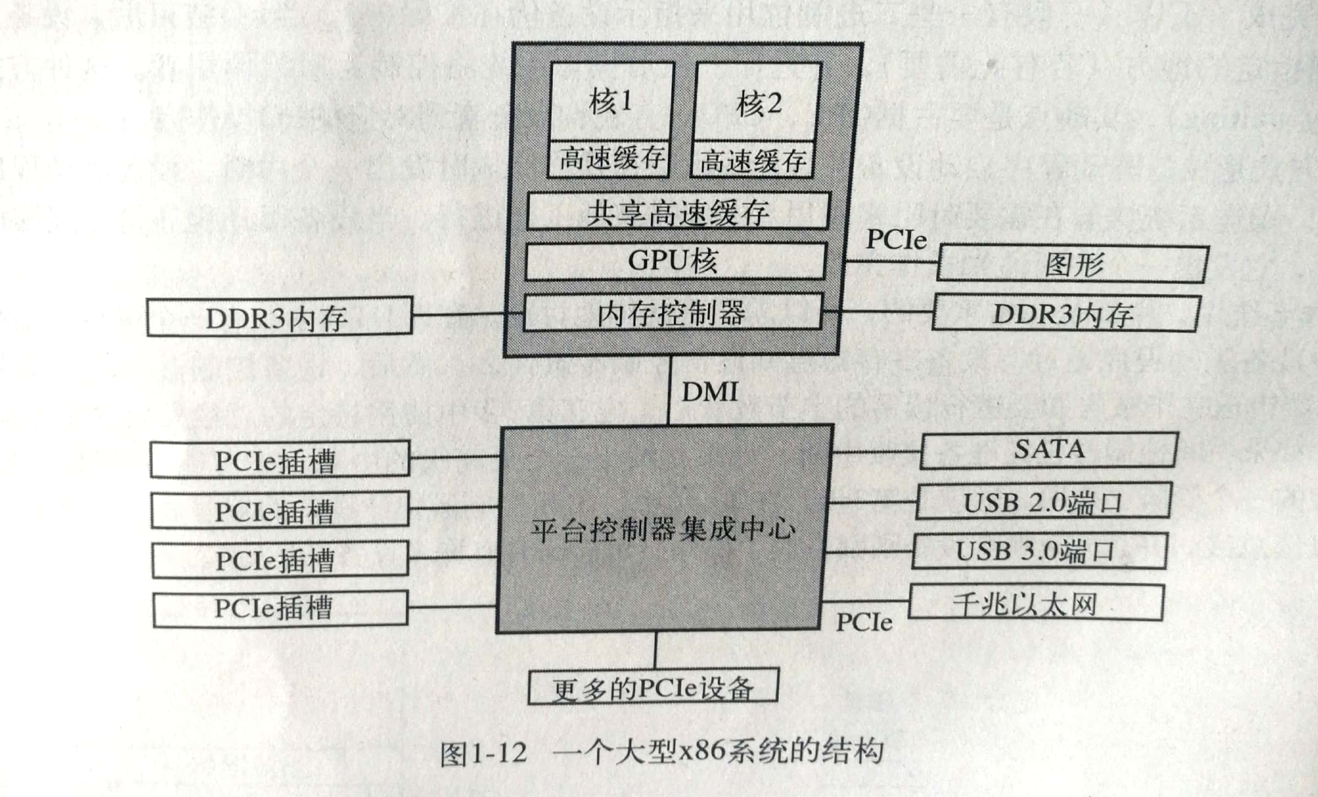
Buses
图中有很多总线（如高速缓存、内存、PCIe、PCI、USB、SATA，MDI）每条总线的传输速度和功能都不同，OS必须了解所有总线的配置与管理。其中主要的总线是PCIe总线）
Notes:
电脑pcie是一种高速串行计算机扩展总线标准，它原来的名称为“3GIO”，是由英特尔在2001年提出的，旨在替代旧的PCI，PCI-X和AGP总线标准。
PCIe属于高速串行点对点双通道高带宽传输，所连接的设备分配独享通道带宽，不共享总线带宽，主要支持主动电源管理，错误报告，端对端的可靠性传输，热插拔以及服务质量(QOS)等功能。PCIe交由PCI-SIG（PCI特殊兴趣组织）认证发布后才改名为“PCI-Express”，简称“PCI-e”。它的主要优势就是数据传输速率高，而且还有相当大的发展潜力。

Slide 40
Bootstrapping
Power up a computer
Processor reset
Set to known state
Jump to ROM code
Load in the boot loader from stable storage
Jump to the boot loader
Load the rest of the operating system
Initialize and run
Boot
loader
Boot
loader
OS
sector 1
OS
sector 2
.
.
.
OS
sector n
Pentium的简要启动过程：母版上BIOS运行、检查设备、通过CMOS存储器中的设备清单决定启动设备、启动设备的一个扇区被读入并执行……
Notes:
Pentium的简要启动过程：母版上BIOS运行：检查所安装的RAM数量、键盘和其他基本设备是否已安装并正常响应，再开始扫描PCIe和PCI总线并找出连在上面的所有设备，通过CMOS存储器中的设备清单决定启动设备、启动设备的第一个扇区被读入并执行，检查分区表确定活动分区。从活动分区读入第二个启动装载模块，读入操作系统，启动操作系统，OS询问BIOS，获得配置信息，对于每种设备，检查对应的启动程序是否存在，没有，系统要求插入或下载驱动程序，一旦有了全部的设备驱动程序，OS将它们调入内核，初始化有关表格，创建需要的进程，并在每个终端上启动登录程序或GUI。

Slide 41
Chapter Outline
What is OS? What does it do?
History of OS
The Operating System Zoo
Computer Hardware overview
Operating System Concepts
System Calls
Operating Systems Structure
Summary
41/75

Slide 42
Operating System Concepts
Processes
Address spaces
Files
Input/Output
Protection
The shell
Ontogeny recapitulates phylogeny（个体重复系统发展）
Large memories
Protection hardware
Disks
Virtual memory

Slide 43
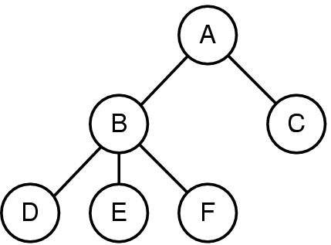
Process: a running program
A process includes
Address space
Process table entries (state, registers)
A process tree
A created two child processes, B and C
B created three child processes, D, E, and F

Slide 44
Processor (CPU) Management
Goals
Time sharing
Multiple CPU allocations
Issues
Do not waste CPU resources
Synchronization and mutual exclusion
Fairness
deadlock free
Analogy: Video Games

Slide 45
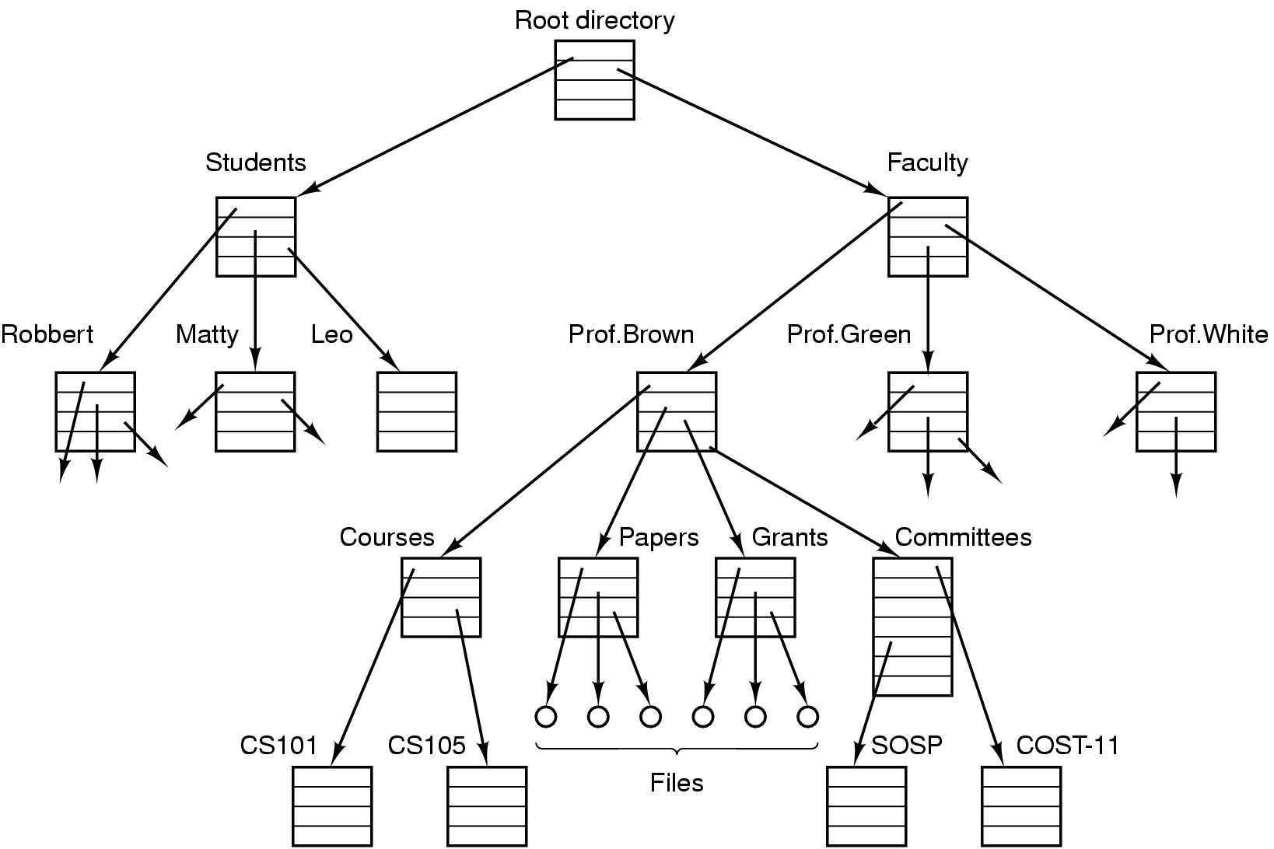
File
File system for a university department

Slide 46
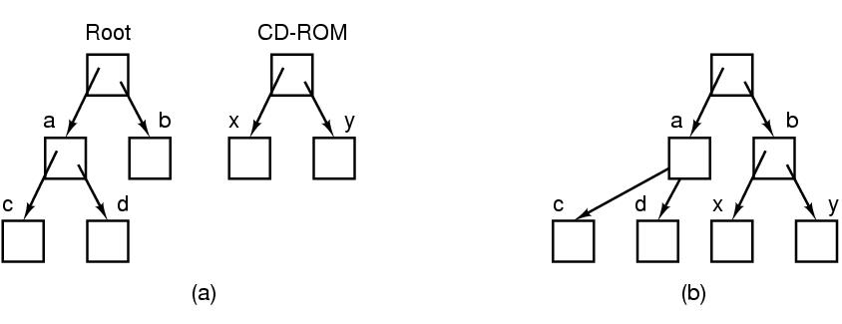
Files (2)---安装文件系统
Figure 1-15. (a) Before mounting, the files on the CD-ROM are not accessible. (b) After mounting, they are part of the file hierarchy.

Slide 47
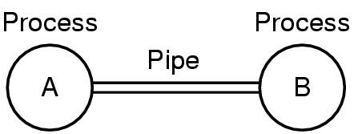
Files
Two processes connected by a pipe（虚文件）

Slide 48
Input/Output
I/O设备包含键盘、显示器、打印机等，对这些设备的管理全然依靠操作系统
每个OS都有管理其I/O设备的I/O子系统。（见chapter 5)

Slide 49
Protection
关系系统的安全性依靠操作系统
文件的安全：
UNIX系统：9位二进制保护代码
3个3位字段，一个对应所有者、一个对用同组用户、一个对应其他用户
eg. rwxr-x—x （八进制数741）的含义是：所有者可读、写、执行；同组用户可读、不能写、可执行；其他用户不可读、不可写、可执行

Slide 50
The shell
操作系统的命令解析器：shell
Shell是终端用户与操作系统之间的接口，除非用户使用的是图形用户接口。
用户登陆时，同时启动了一个shell,显示提示符，提示用户shell正在等待接收命令：
$ date > file
$ cp src dest
$ sort < in >out
$ sort <in >temp; head -30 <temp; rm temp
$ wc –l <a >b &
$ Sort <x |head &

Slide 51
Chapter Outline
What is OS? What does it do?
History of OS
The Operating System Zoo
Computer Hardware overview
Operating System Concepts
System Calls
Operating Systems Structure
Summary
51/75

Slide 52
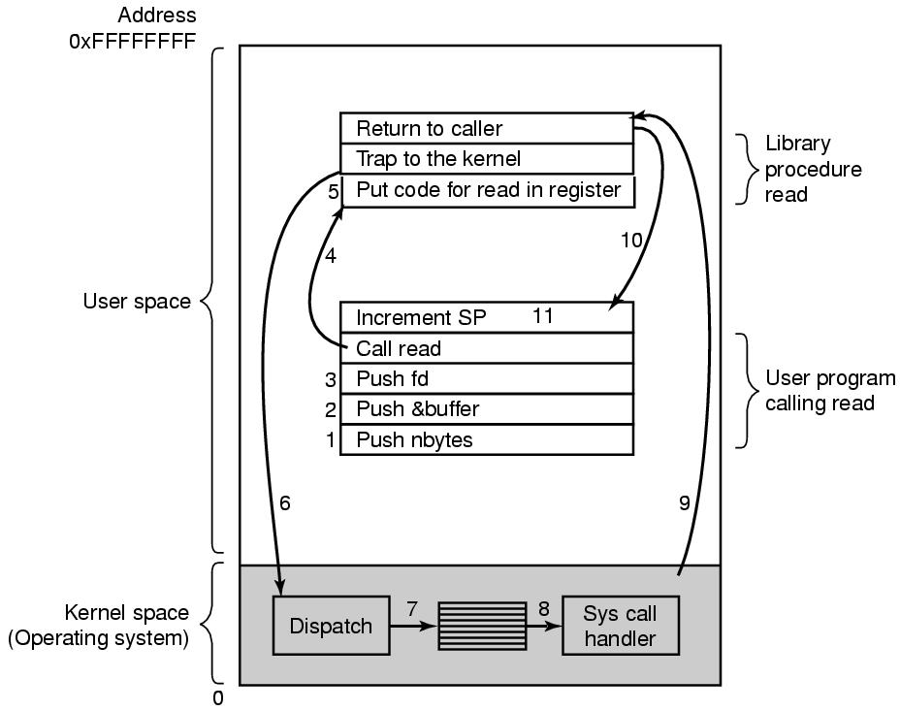
System Calls
Figure 1-17. The 11 steps in making the system call read(fd, buffer, nbytes).

Slide 53
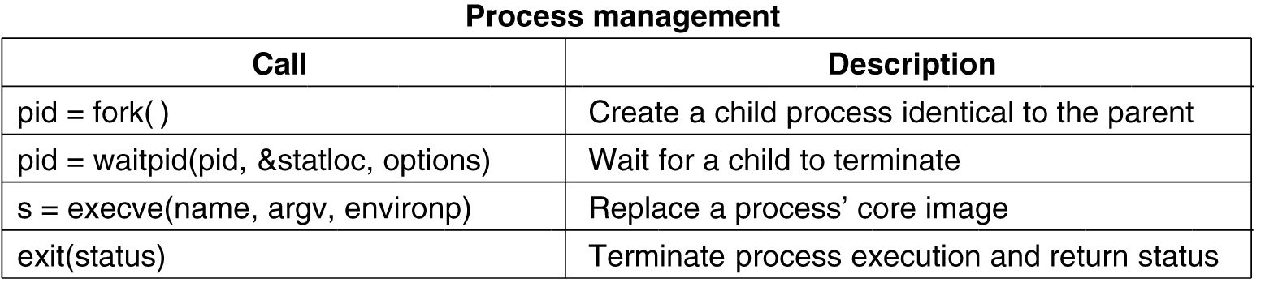
System Calls for Process Management
Figure 1-18. Some of the major POSIX system calls.

Slide 54
System Calls for File Management (1)
Figure 1-18. Some of the major POSIX system calls.

Slide 55
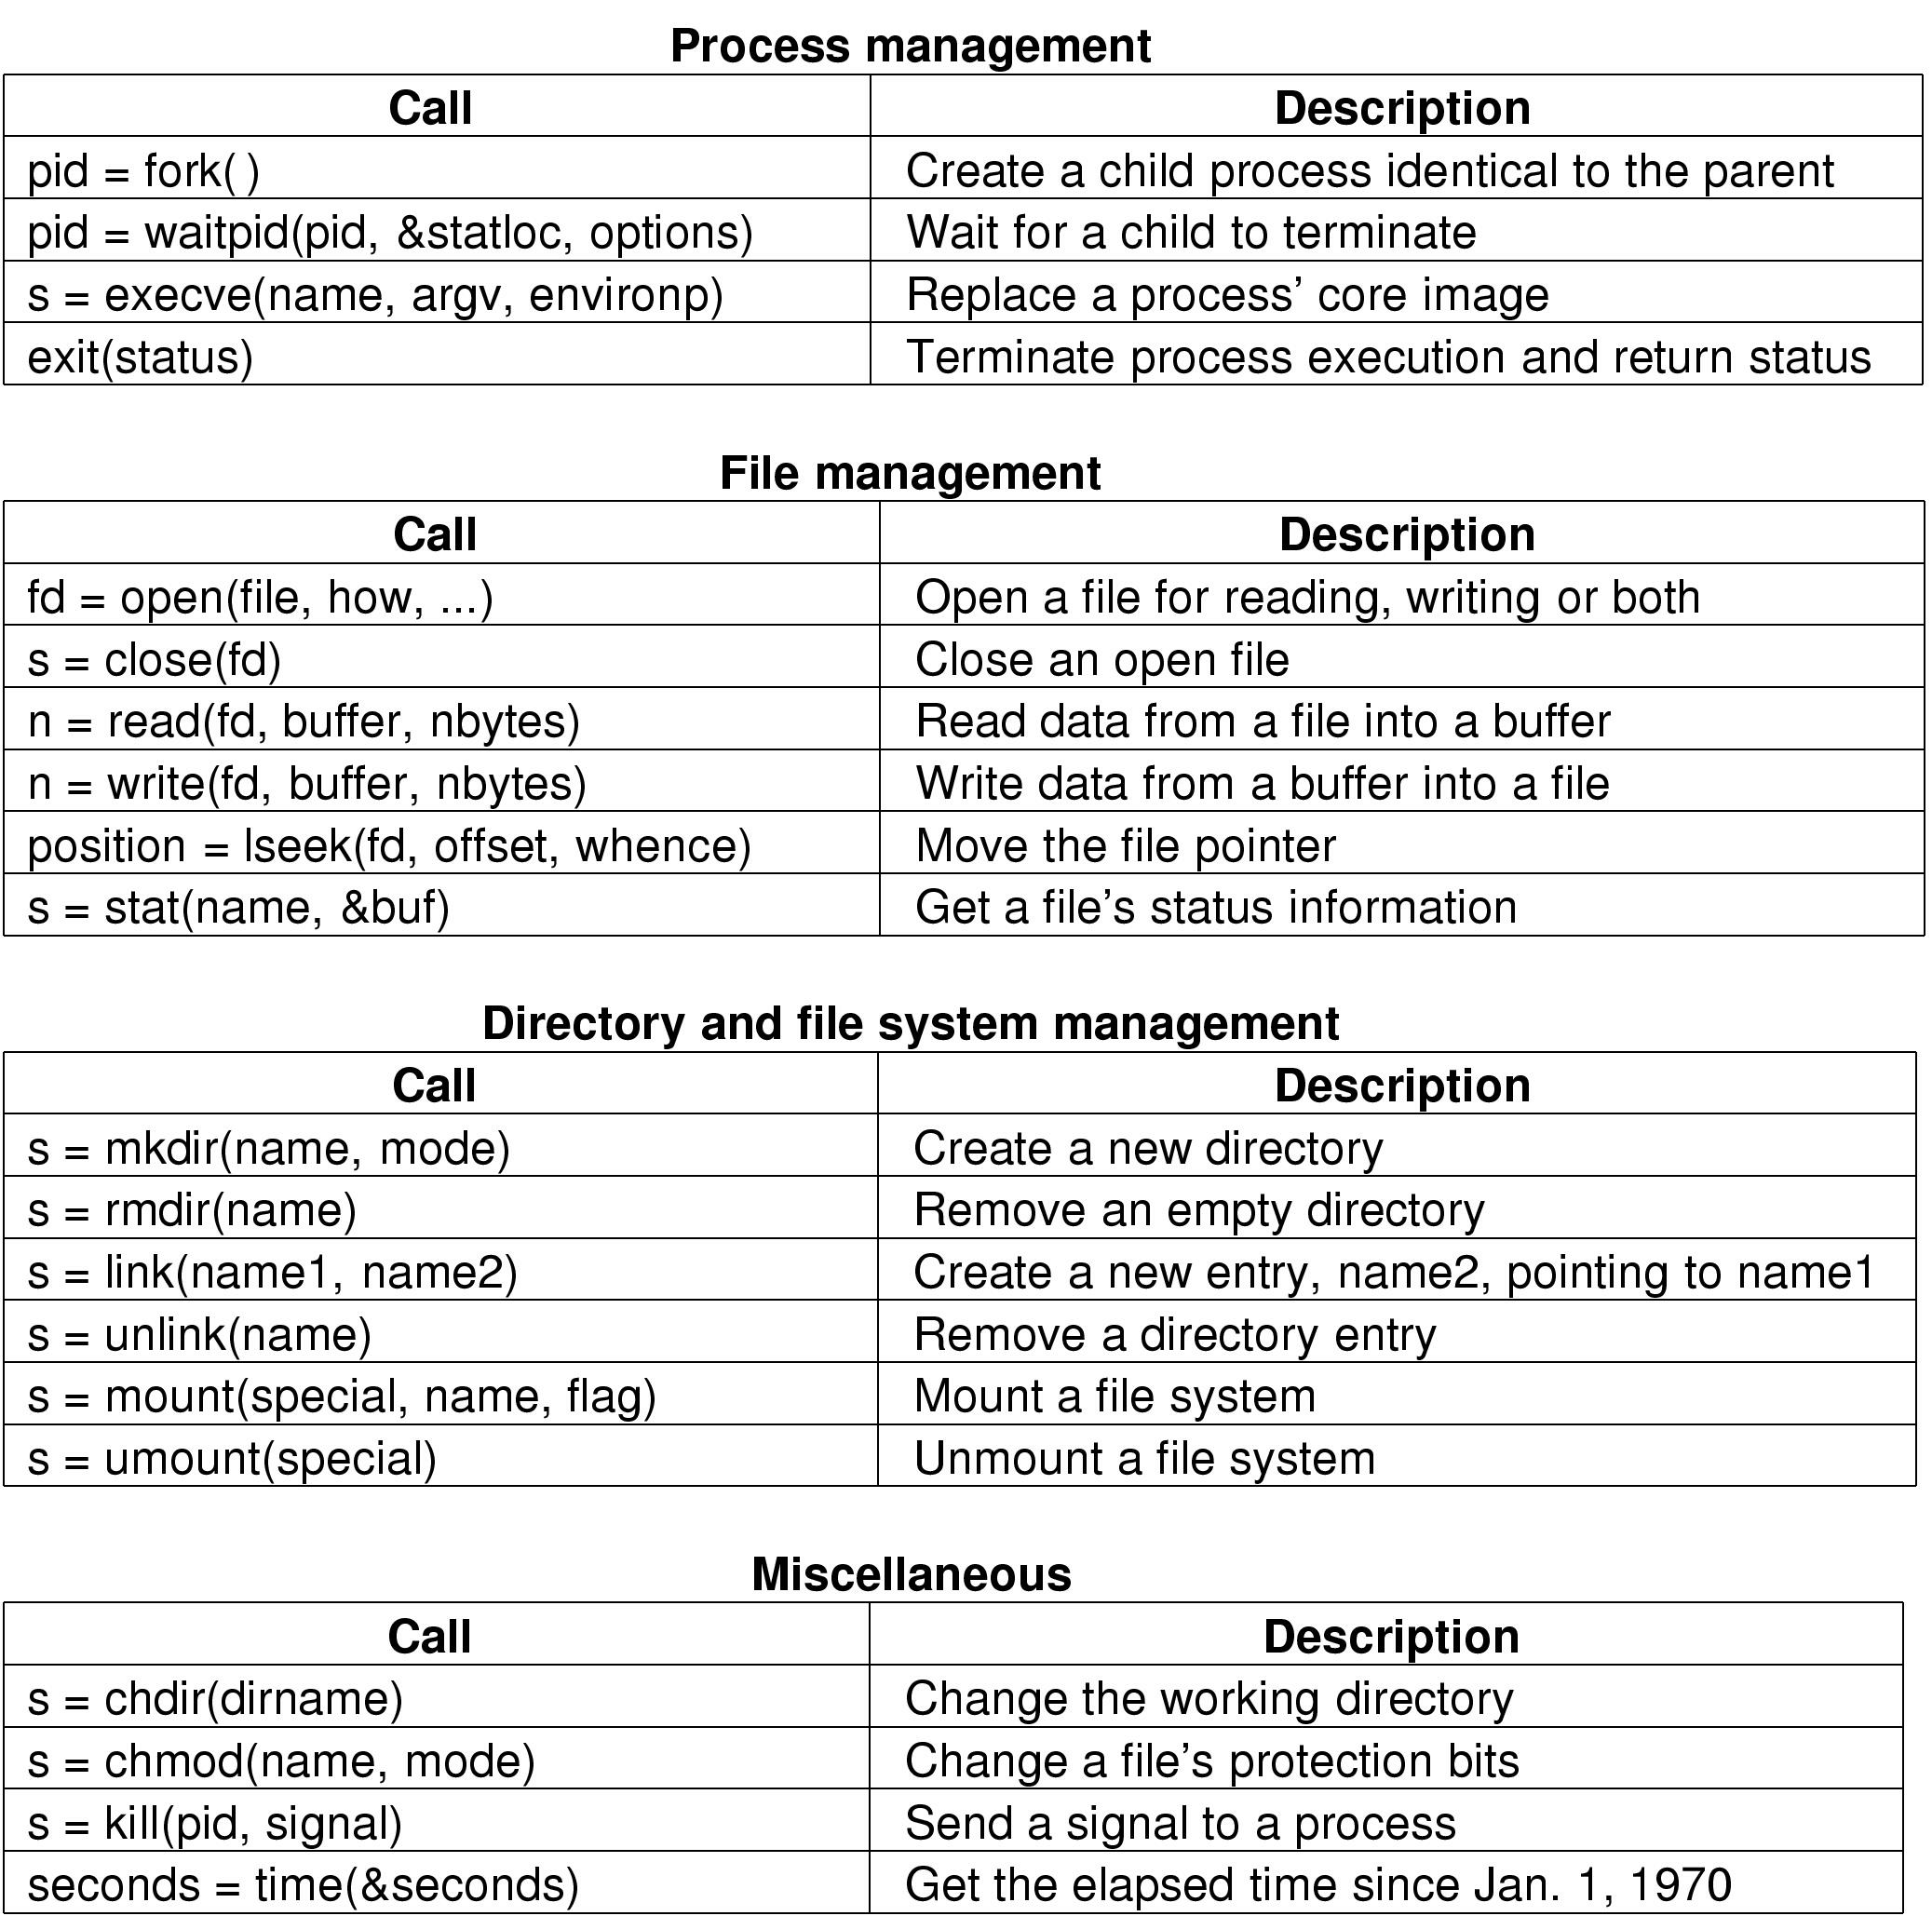
Some System Calls For Directory Management
Figure 1-18. Some of the major POSIX system calls.

Slide 56
Some System Calls For Miscellaneous Tasks
Figure 1-18. Some of the major POSIX system calls.

Slide 57
System Calls (1)
A stripped down shell:
while (TRUE) { /* repeat forever */
type_prompt( ); /* display prompt */
read_command (command, parameters) /* input from terminal */
if (fork() != 0) { /* fork off child process */
/* Parent code */
waitpid( -1, &status, 0); /* wait for child to exit */
} else {
/* Child code */
execve (command, parameters, 0); /* execute command */
}
}

Slide 58
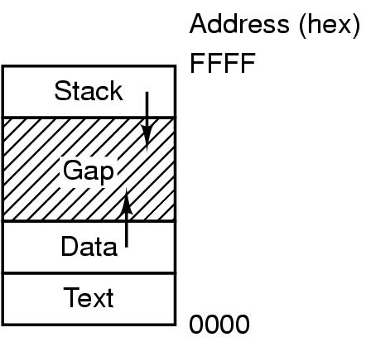
Memory Layout
Processes have three segments: text, data, stack

Slide 59
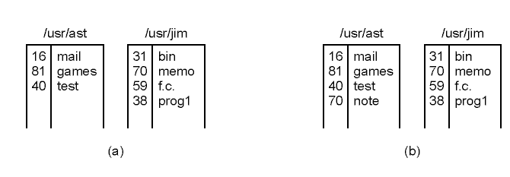
用于目录管理的系统调用----Linking （link(“usr/jim/memo”,”usr/ast/note”); 在jim目录中的文件memo以文件名 note进入ast的目录
(a) Two directories before linking /usr/jim/memo to ast's directory
(b) The same directories after linking

Slide 60
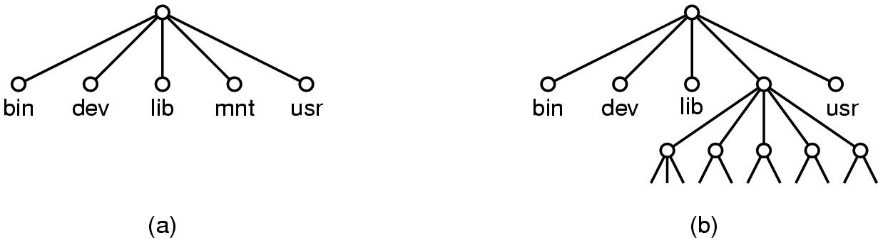
Mounting mount(“/dev/fd0”,”/mnt”,0); 将CD-ROM文件系统添加到根文件系统
只读
(a) File system before the mount
(b) File system after the mount

Slide 61
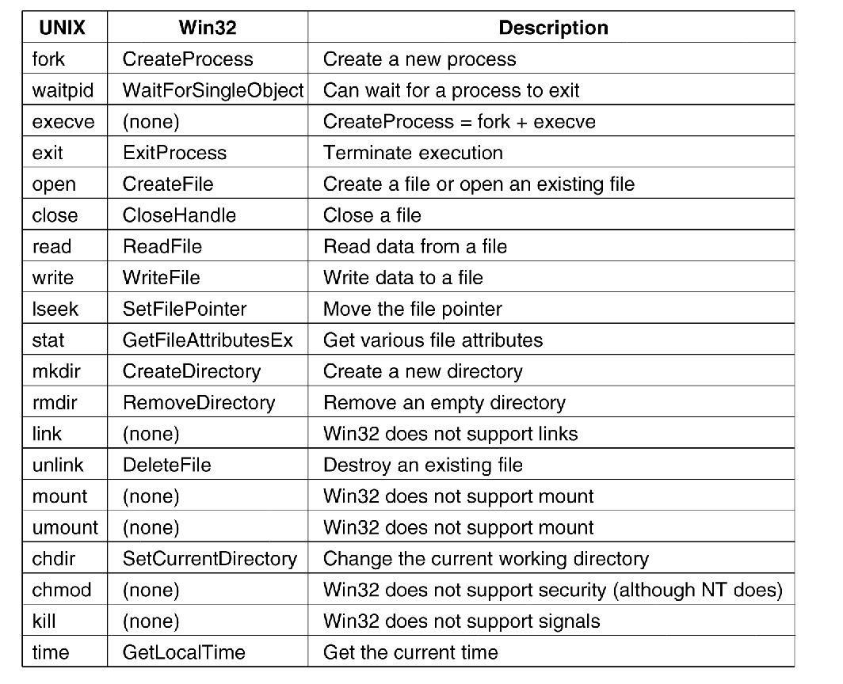
Windows Win32 API
Figure 1-23. The Win32 API calls that roughly correspond to the UNIX calls of Fig. 1-18.

Slide 62
Chapter Outline
What is OS? What does it do?
History of OS
The Operating System Zoo
Computer Hardware overview
Operating System Concepts
System Calls
Operating Systems Structure
Summary
62/75

Slide 63
Operating Systems Structure
Monolithic systems（单(整)体
Layered Systems（层次结构）
Microkernels
Client-Server Model
Virtual Machines
Exokernel (外核）

Slide 64
Operating Systems Structure
全部OS在内核态中以单一程序的方式运行。整个操作系统以过程集合的方式编写，链接成一个大型可执行二进制程序）
Monolithic systems（单(整)体） – basic structure:
A main program that invokes the requested service procedure.
A set of service procedures that carry out the system calls.
A set of utility procedures that help the service procedures.

Slide 65
简单的单（整）体系统结构模型
A main program
主过程
_ _ __ _ __ _ __ _ __ _ __ _ __ _ _ __ _ __ _ __ _ __ _ _ __ _ __ _
_ _ __ _ __ _ __ _ __ _ __ _ __ _ _ __ _ __ _ __ _ __ _ _ __ _ __ _
service procedures
服务过程
utility procedures实用过程
分成简单的三层

Slide 66
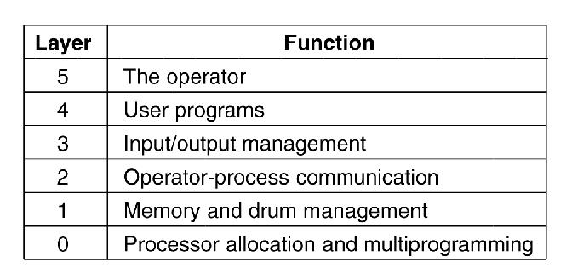
Layered Systems（层次结构）
上层软件都是在下一层软件的基础上构建的
Figure 1-25. Structure of the THE operating system（ 1968年批处理OS，E.W.Dijkstra和他的学生在荷兰的Eindhoven技术学院所开发）
（六层：CPU管理、内存和磁鼓管理、操作员-进程通信、输入/输出管理、用户程序、系统操作员）
MULTICS系统中采用更进一步的通用层次化概念：由许多同心环构造而成，内层环比外层环有更高的级别。

Slide 67
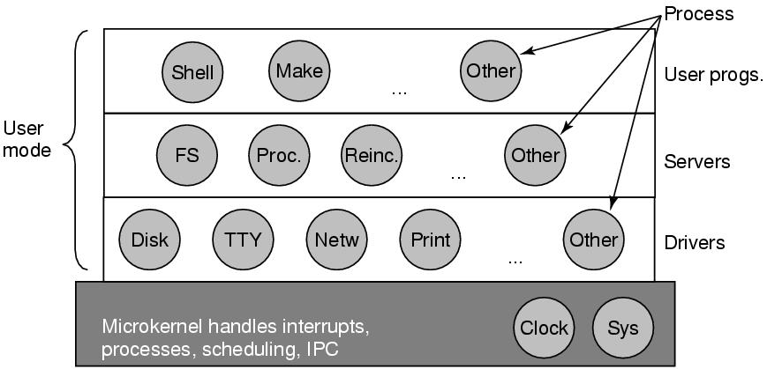
Microkernels
Figure 1-26. Structure of the MINIX 3 system.
其微内核只有3200行C语言代码和800行汇编代码
微内核设计思路：为了可靠，将OS划分为小的、良好定义的模块，只有其中一个模块----微内核----运行在内核态上，其余模块则作为普通用户进程运行，以防止这些模块的错误导致系统死机。

Slide 68
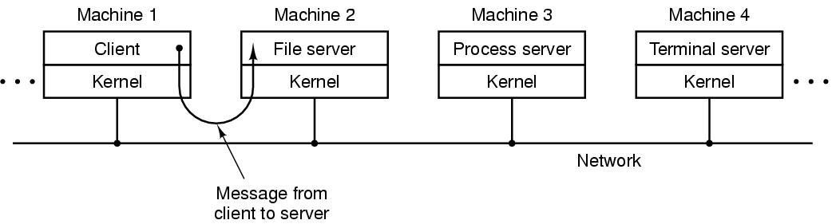
Client-Server Model
Figure 1-27. The client-server model over a network.
将进程划分为两类：服务器、客户机
该模式可以应用在单机或网络机器上的抽象
许多Web就是以这种方式运行的：PC机向某个服务器请求一个Web页面，服务器将页面送回。

Slide 69
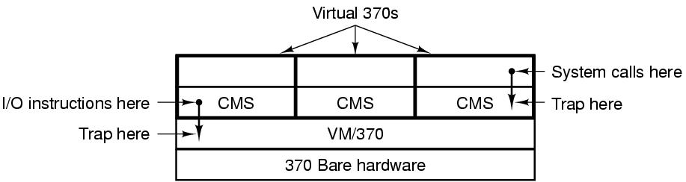
Virtual Machines (1)
----WM/370
Figure 1-28. The structure of VM/370 with CMS（Conversation Monitor System).
虚拟机是裸机硬件的精确复制品
现代的z/VM通常用于运行多个完整的操作系统，而非如CMS一样的单用户系统

Slide 70
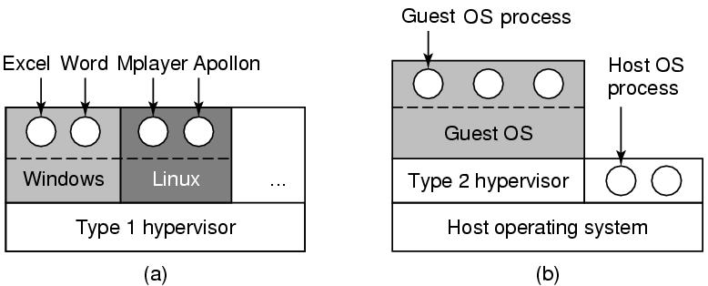
Virtual Machines (2)
----虚拟机的重现
可用于：托管；同时运行两个或多个OS.
Figure 1-29. (a) A type 1 hypervisor. (b) A type 2 hypervisor.

Slide 71
Exokernel (外核）
对机器进行分区。给每个用户整个资源的一个子集。
在底层，一种称为外核（exokernel)的程序在内核态中运行。其任务是为虚拟机分配资源，并检查试图使用这些资源的企图，以确保没有机器会使用他人的资源。
优点：
减少了映像层。外核只需要记录已经分配给各个虚拟机的有关资源即可。
将多道程序（在外核内）与用户操作系统代码（在用户空间内）加以分离，而且相应负载并不重（Exokernel只是保持多个虚拟机彼此不发生冲突）。

Slide 72
Design Tradeoffs
All in the kernel (Windows)
Pros: efficient?
Cons: difficult to develop new services
All at user level
Pros: easy to develop new apps
Cons: protection
Split between user and kernel (Unix)
Kernel: display driver and mouse driver
User: the rest
72/75
Notes:
72

Slide 73
Operating Systems Structure
Monolithic systems（单(整)体（简单三层）
分层
Layered Systems（层次结构）
可靠 （划分内核与用户的边界）
Microkernels
将进程分成服务器和客户端两类
Client-Server Model
建立虚拟机监控，对裸机硬件的复制品
Virtual Machines
建立在内核态运行的Exokernel,为虚拟机分配管理资源
Exokernel (外核）

Slide 74
The World According to C
OS通常是由许多程序员写成的，包括很大部分的C（有时是C++）程序。
The C language
Header files
Large programming projects
The model of run time

Slide 75
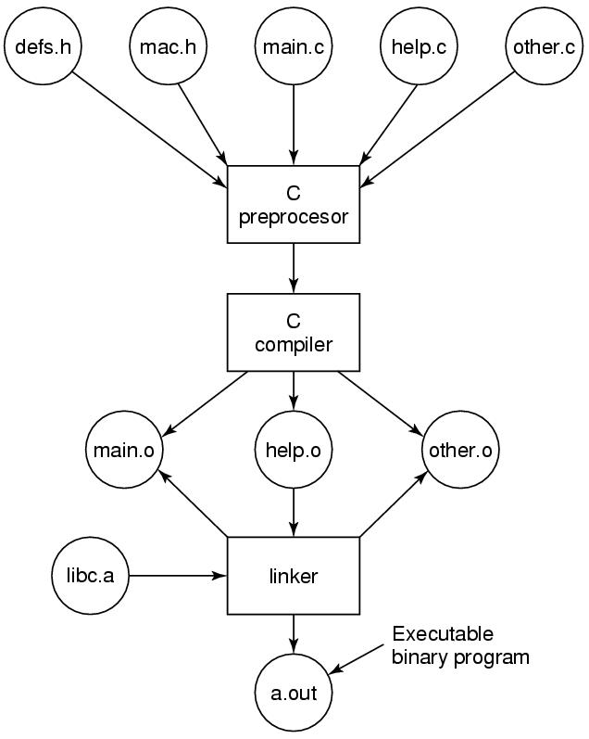
C语言运行模型
编译C和头文件，构建可执行文件的过程

Slide 76
Summary
Course overview
Policy and requirement
What is OS?
OS history
Hardware overview
Operating System Concepts
System Calls
Operating Systems Structure
Next lecture: Process (Chapter 2)

Slide 77
After this lecture…
Reading assignment: chapter 1
Start next week with Chapter 2
Homework:
P46-47: 3,15,16,18, 23
Notes:
To conclude, welcome to the course, start reading chapter 1, and think about Resources, operating systems, and what is wrong with them.
Visit our Web site.
See if you can use the webboard.

